Slide 1
Lecture 12 – Discrete-Time Markov Chains
Topics
State-transition matrix
Network diagrams
Examples: gambler’s ruin, brand switching, IRS, craps
Transient probabilities
Steady-state probabilities

Slide 2
Discrete – Time Markov Chains
Many real-world systems contain uncertainty and
evolve over time.
Stochastic processes (and Markov chains)
are probability models for such systems.
A discrete-time stochastic process
is a sequence of random variables
X₀, X₁, X₂, . . . typically denoted by { X_{n} }.
Origins: Galton-Watson process → When and with what probability will a family name become extinct?

Slide 3
Components of Stochastic Processes
The state space of a stochastic process is
the set of all values that the X_{n}’s can take.
(we will be concerned with
stochastic processes with a finite # of states )
Time: n = 0, 1, 2, . . .
State: v-dimensional vector, s = (s₁, s₂, . . . , s_{v})
In general, there are m states,
s¹, s², . . . , s^{m} or s⁰, s¹, . . . , s^{m-1}
Also, X_{n} takes one of m values, so X_{n} ↔ s.

Slide 4
Gambler’s Ruin
At time 0 I have X₀ = $2, and each day I make a $1 bet. I win with probability p and lose with probability 1– p. I’ll quit if I ever obtain $4 or if I lose all my money.
State space is S = { 0, 1, 2, 3, 4 }
Let X_{n} = amount of money I have after the bet on day n.
If X_{n} = 4, then X_{n+1} = X_{n+2} = • • • = 4.
If X_{n} = 0, then X_{n+1} = X_{n+2} = • • • = 0.

Slide 5
Markov Chain Definition
A stochastic process { X_{n} } is called a Markov chain if
Pr{ X_{n+1} = j | X₀ = k₀, . . . , X_{n-1} = k_{n-1}, X_{n} = i }
= Pr{ X_{n+1} = j | X_{n} = i } ← transition probabilities
for every i, j, k₀, . . . , k_{n-1} and for every n.
Discrete time means n ∈ N = { 0, 1, 2, . . . }.
The future behavior of the system depends only on the
current state i and not on any of the previous states.

Slide 6
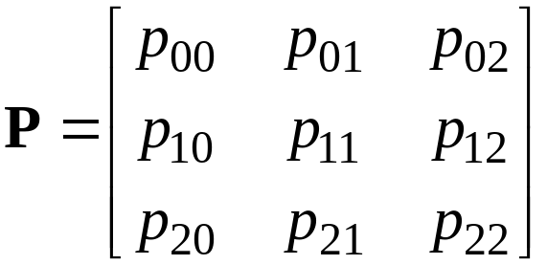
Stationary Transition Probabilities
Pr{ X_{n+1} = j | X_{n} = i } = Pr{ X₁ = j | X₀ = i } for all n
(They don’t change over time)
We will only consider stationary Markov chains.
The one-step transition matrix for a Markov chain
with states S = { 0, 1, 2 } is
where p_{ij} = Pr{ X₁ = j | X₀ = i }

Slide 7
Properties of Transition Matrix
If the state space S = { 0, 1, . . . , m –1} then we have
∑_{j} p_{ij} = 1 ∀ i and p_{ij} ≥ 0 ∀ i, j
(we must (each transition
go somewhere) has probability ≥ 0)
Gambler’s Ruin Example
₀ ₁ ₂ ₃ ₄
₀ ₁ ₀ ₀ ₀ ₀
_{1 1-p 0 p 0 0}
_{2 0 1-p 0 p 0}
_{3 0 0 1-p 0 p}
₄ ₀ ₀ ₀ ₀ ₁

Slide 8
Computer Repair Example
Two aging computers are used for word processing.
When both are working in morning, there is a 30% chance that one will fail by the evening and a 10% chance that both will fail.
If only one computer is working at the beginning of the day, there is a 20% chance that it will fail by the close of business.
If neither is working in the morning, the office sends all work to a typing service.
Computers that fail during the day are picked up the following morning, repaired, and then returned the next morning.
The system is observed after the repaired computers have been returned and before any new failures occur.

Slide 9
States for Computer Repair Example
Index
State
State definitions
0
s = (0)
No computers have failed. The office starts the day with both computers functioning properly.
1
s = (1)
One computer has failed. The office starts the day with one working computer and the other in the shop until the next morning.
2
s = (2)
Both computers have failed. All work must be sent out for the day.

Slide 10
Events and Probabilities for Computer Repair Example
Current state
Events
Prob-ability
Next state
Index
0
s⁰ = (0)
Neither computer fails.
0.6
s' = (0)
One computer fails.
0.3
s' = (1)
Both computers fail.
0.1
s' = (2)
1
s¹ = (1)
Remaining computer does not fail and the other is returned.
0.8
s' = (0)
Remaining computer fails and the other is returned.
0.2
s' = (1)
2
s² = (2)
Both computers are returned.
1.0
s' = (0)

Slide 11
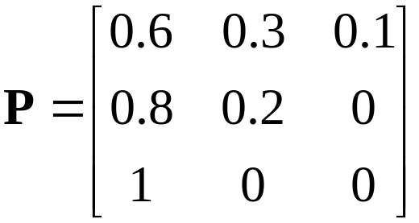
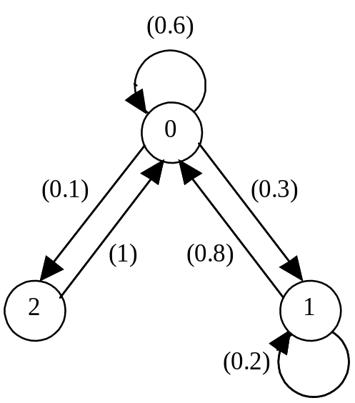
State-Transition Matrix and Network
The events associated with a Markov chain can be described by the m × m matrix: P = (p_{ij}).
For computer repair example, we have:
State-Transition Network
  Node for each state
  Arc from node i to node j if p_{ij} > 0.
For computer repair example:

Slide 12
Procedure for Setting Up a DTMC
Specify the times when the system is to be observed.
Define the state vector s = (s₁, s₂, . . . , s_{v}) and list all the states. Number the states.
For each state s at time n identify all possible next states s' that may occur when the system is observed at time n + 1.
Determine the state-transition matrix P = (p_{ij}).
Draw the state-transition diagram.

Slide 13
Repair Operation Takes Two Days
One repairman, two days to fix computer.
→ new state definition required: s = (s₁, s₂)
s₁ = day of repair of the first machine
s₂ = status of the second machine (working or needing repair)
For s₁, assign 0 if 1st machine has not failed
1 if today is the first day of repair
2 if today is the second day of repair
For s₂, assign 0 if 2nd machine has not failed
1 if it has failed

Slide 14
State Definitions for 2-Day Repair Times
Index | State | State definitions
0 | s⁰ = (0, 0) | No machines have failed.
1 | s¹ = (1, 0) | One machine has failed and today is in the first day of repair.
2 | s² = (2, 0) | One machine has failed and today is in the second day of repair.
3 | s³ = (1, 1) | Both machines have failed; today one is in the first day of repair and the other is waiting.
4 | s⁴ = (2, 1) | Both machines have failed; today one is in the second day of repair and the other is waiting.

Slide 15
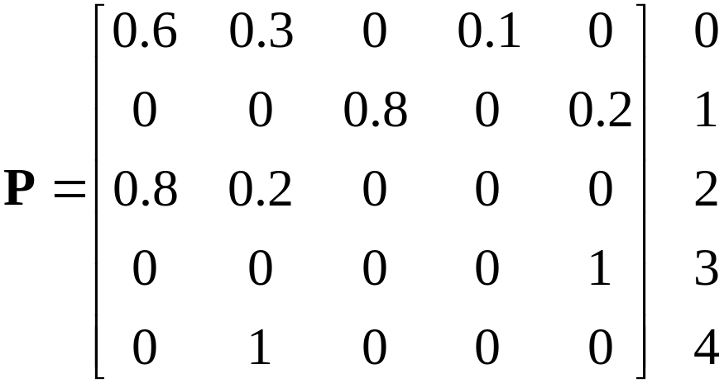
State-Transition Matrix for 2-Day Repair Times
0 1 2 3 4
For example, p₁₄ = 0.2 is probability of going from state 1 to state 4 in one day,where s¹ = (1, 0) and s⁴ = (2, 1)

Slide 16
Brand Switching Example
Number of consumers switching from brand i in week 26 to brand j in week 27
Brand | (j) 1 | 2 | 3 | Total
(i)
1 | 90 | 7 | 3 | 100
2 | 5 | 205 | 40 | 250
3 | 30 | 18 | 102 | 150
Total | 125 | 230 | 145 | 500
This is called a contingency table.
→ Used to construct transition probabilities.

Slide 17
Empirical Transition Probabilities for Brand Switching, p_{ij}
Brand | (j) 1 | 2 | 3
(i)
1
2
3
Steady state →

Slide 18
Markov Analysis
State variable, X_{n} = brand purchased in week n
{X_{n}} represents a discrete state and discrete time stochastic process, where S = {1, 2, 3} and N = {0, 1, 2, . . .}.
If {X_{n}} has Markovian property and P is stationary, then a Markov chain should be a reasonable representation of aggregate consumer brand switching behavior.
Potential Studies
- Predict market shares at specific future points in time.
- Assess rates of change in market shares over time.
- Predict market share equilibriums (if they exist).
- Evaluate the process for introducing new products.

Slide 19
Transform a Process to a Markov Chain
Sometimes a non-Markovian stochastic process can be transformed into a Markov chain by expanding the state space.
Example: Suppose that the chance of rain tomorrow depends on the weather conditions for the previous two days (yesterday and today).
Specifically,
Pr{ rain tomorrow⏐rain last 2 days (RR) } = 0.7
Pr{ rain tomorrow⏐rain today but not yesterday (NR) } = 0.5
Pr{ rain tomorrow⏐rain yesterday but not today (RN) } = 0.4
Pr{ rain tomorrow⏐no rain in last 2 days (NN) } = 0.2
Does the Markovian Property Hold ?

Slide 20
The Weather Prediction Problem
How to model this problem as a Markov Process ?
The state space: 0 = (RR) 1 = (NR) 2 = (RN) 3 = (NN)
The transition matrix:
0(RR) 1(NR) 2(RN) 3(NN)
0 (RR) 0.7 0 0.3 0
P = 1 (NR) 0.5 0 0.5 0
2 (RN) 0 0.4 0 0.6
3 (NN) 0 0.2 0 0.8
This is a discrete-time Markov process.

Slide 21
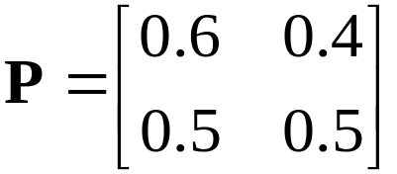
Multi-step (n-step) Transitions
The P matrix is for one step: n to n + 1.
How do we calculate the probabilities for transitions involving more than one step?
Consider an IRS auditing example:
Two states: s⁰ = 0 (no audit), s¹ = 1 (audit)
Transition matrix
Interpretation: p₀₁ = 0.4, for example, is conditional probability of an audit next year given no audit this year.

Slide 22
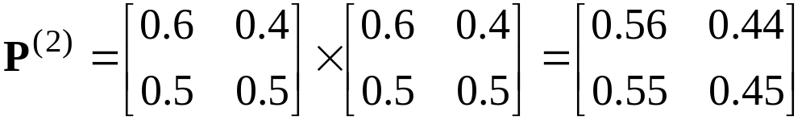
Two-step Transition Probabilities
(2)
Let p_{ij} be probability of going from i to j in two transitions.
In matrix form, P⁽²⁾ = P × P, so for IRS example we have
The resultant matrix indicates, for example, that the probability of no audit 2 years from now given that the current year there was no audit is p₀₀ = 0.56.
(2)

Slide 23
n-Step Transition Probabilities
This idea generalizes to an arbitrary number of steps.
For n = 3: P⁽³⁾ = P⁽²⁾ P = P² P = P³
or more generally, P^{(n)} = P^{(m)} P^{(n-m)}
The ij th entry of this reduces to
p_{ij}^{(n)} = ∑ p_{ik}^{(m)} p_{kj}^{(n-m)} 1 ≤ m ≤ n−1
m
k =0
Chapman - Kolmogorov Equations
Interpretation:
RHS is the probability of going from i to k in m steps & then going from k to j in the remaining n − m steps, summed over all possible intermediate states k.

Slide 24
n-Step Transition Matrix for IRS Example
Time, n
Transition matrix, P^{(n)}
1
2
3
4
5

Slide 25
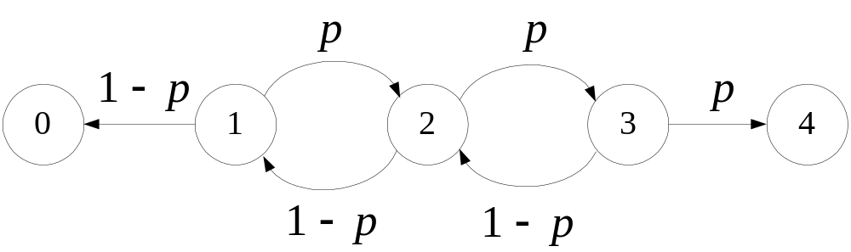
Gambler’s Ruin Revisited for p = 0.75
State-transition network
State-transition matrix
₀ ₁ ₂ ₃ ₄
₀ ₁ ₀ ₀ ₀ ₀
_{1 0.25 0 0.75 0 0}
_{2 0 0.25 0 0.75 0}
_{3 0 0 0.25 0 0.75}
₄ ₀ ₀ ₀ ₀ ₁

Slide 26
Gambler’s Ruin with p = 0.75, n = 30
0 1 2 3 4
0 1 0 0 0 0
1 0.325 ε 0 ε 0.675
2 0.1 0 ε 0 0.9
3 0.025 ε 0 ε 0.975
4 0 0 0 0 1
P⁽³⁰⁾ =
(ε is very small nonunique number)
What does matrix mean?
A steady state probability does not exist.

Slide 27
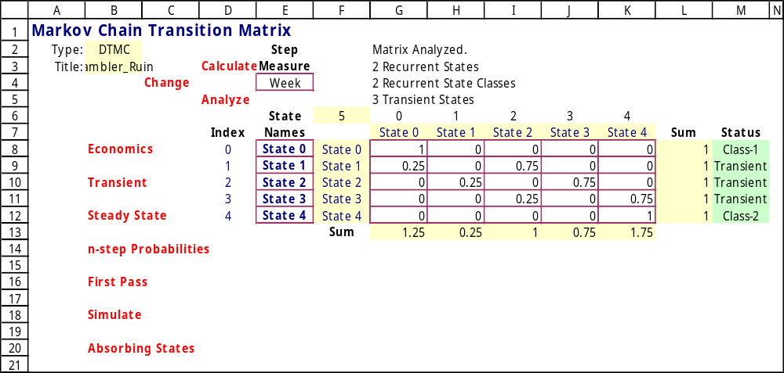
DTMC Add-in for Gambler’s Ruin

Slide 28
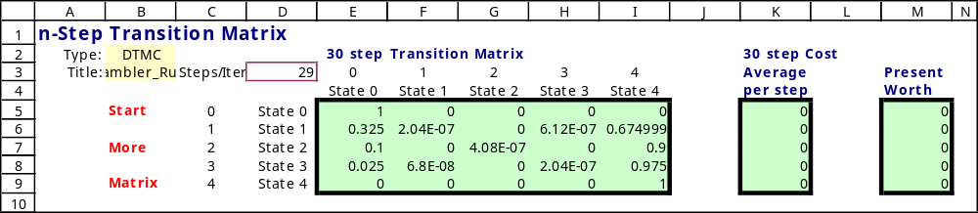
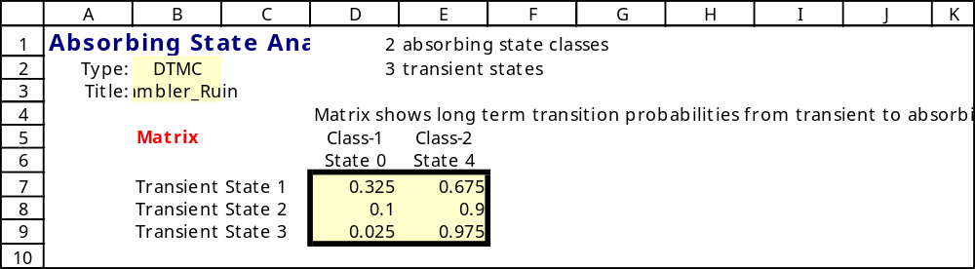
30-Step Transition Matrix for Gambler’s Ruin
Limiting probabilities

Slide 29
Conditional vs. Unconditional Probabilities
Let state space S = {1, 2, . . . , m }.
Let p_{ij} be conditional n-step transition probability → P^{(n)}.
Let q(n) = (q₁(n), . . . , q_{m}(n)) be vector of all unconditional probabilities for all m states after n transitions.
^{(n)}
Perform the following calculations:
q(n) = q(0)P^{(n)} or q(n) = q(n–1)P
where q(0) is initial unconditional probability.
The components of q(n) are called the transient probabilities.

Slide 30
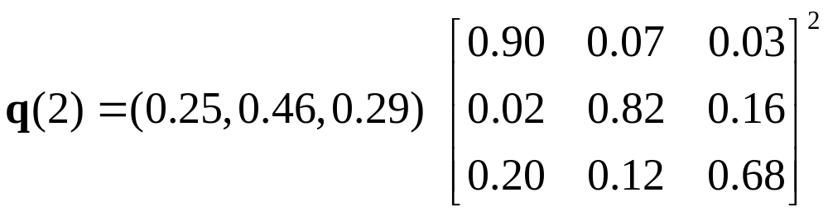
Brand Switching Example →
We approximate q_{i} (0) by dividing total customers using brand i in week 27 by total sample size of 500:
q(0) = (125/500, 230/500, 145/500) = (0.25, 0.46, 0.29)
To predict market shares for, say, week 29 (that is, 2 weeks into the future), we simply apply equation with n = 2:
q(2) = q(0)P⁽²⁾
= (0.327, 0.406, 0.267)
= expected market share from brands 1, 2, 3

Slide 31
Transition Probabilities for n Steps
Property 1: Let {X_{n} : n = 0, 1, . . .} be a Markov chain with state space S and state-transition matrix P. Then for i and j ∈ S, and n = 1, 2, . . .
Pr{X_{n} = j | X₀ = i} = p_{ij}
where the right-hand side represents the ij^{th} element of the matrix P^{(n)}.
^{(n)}

Slide 32
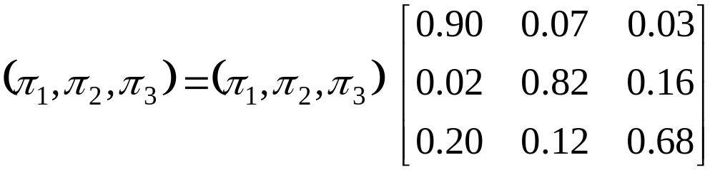
Steady-State Probabilities
Property 2: Let π = (π₁, π₂, . . . , π_{m}) is the m-dimensional row vector of steady-state (unconditional) probabilities for the state space S = {1,…,m}. To find steady-state probabilities, solve linear system:
π = πP, Σ_{j=1,m} π_{j} = 1, π_{j} ≥ 0, j = 1,…,m
Brand switching example:
π₁ + π₂ + π₂ = 1, π₁ ≥ 0, π₂ ≥ 0, π₃ ≥ 0

Slide 33
Steady-State Equations for Brand Switching Example
π₁ = 0.90π₁ + 0.02π₂ + 0.20π₃
π₂ = 0.07π₁ + 0.82π₂ + 0.12π₃
π₃ = 0.03π₁ + 0.16π₂ + 0.68π₃
π₁ + π₂ + π₃ = 1
π₁ ≥ 0, π₂ ≥ 0, π₃ ≥ 0
Total of 4 equations in 3 unknowns
➔ Discard 3rd equation and solve the remaining system to get :
π₁ = 0.474, π₂ = 0.321, π₃ = 0.205
➔ Recall: q₁(0) = 0.25, q₂(0) = 0.46, q₃(0) = 0.29

Slide 34
Comments on Steady-State Results
1. Steady-state predictions are never achieved in actuality due to a combination of
(i) errors in estimating P
(ii) changes in P over time
(iii) changes in the nature of dependence relationships
among the states.
Nevertheless, the use of steady-state values is an important diagnostic tool for the decision maker.
Steady-state probabilities might not exist unless the Markov chain is ergodic.

Slide 35
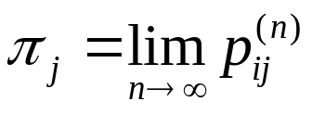
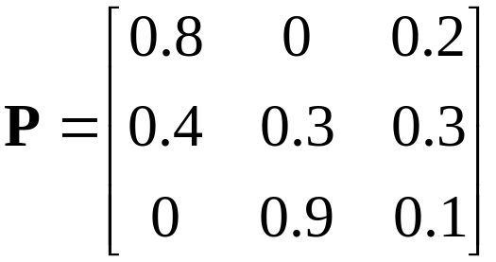
Existence of Steady-State Probabilities
A Markov chain is ergodic if it is aperiodic and allows the attainment of any future state from any initial state after one or more transitions. If these conditions hold, then
For example,
State-transition network
1
2
3
Conclusion: chain is ergodic.
 Craps

Slide 36
Game of Craps
The game of craps is played as follows. The player rolls a pair of dice and sums the numbers showing.
  Total of 7 or 11 on the first rolls wins for the player
  Total of 2, 3, 12 loses
  Any other number is called the point.
The player rolls the dice again.
  If she rolls the point number, she wins
  If she rolls number 7, she loses
  Any other number requires another roll
The game continues until he/she wins or loses

Slide 37
Game of Craps as a Markov Chain
All the possible states
Start
Win
Lose
P4
P5
P6
P8
P9
P10
Continue

Slide 38
Game of Craps Network
not (4,7)
not (5,7)
not (6,7)
not (8,7)
not (9,7)
not (10,7)
P4
P5
P6
P8
P9
P10
5
6
8
4
9
7
7
7
7
5
6
8
9
7
Win
10
10
7
Lose
4
(7, 11)
Start
(2, 3, 12)

Slide 39
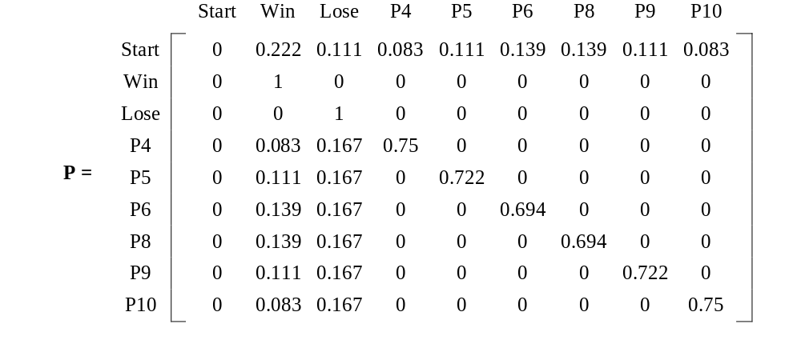
Game of Craps
Sum | 2 | 3 | 4 | 5 | 6 | 7 | 8 | 9 | 10 | 11 | 12
Prob. | 0.028 | 0.056 | 0.083 | 0.111 | 0.139 | 0.167 | 0.139 | 0.111 | 0.083 | 0.056 | 0.028
Probability of win = Pr{ 7 or 11 } = 0.167 + 0.056 = 0.223
Probability of loss = Pr{ 2, 3, 12 } = 0.028 + 0.056 + 0.028 = 0.112

Slide 40
Transient Probabilities for Craps
Roll,
n
q
(
n
)
Start
Win
Lose
P4
P5
P6
P8
P9
P10
0
q
(0)
1
0
0
0
0
0
0
0
0
1
q
(1)
0
0.222
0.111
0.083
0.111
0.139
0.139
0.111
0.083
2
q
(2)
0
0.299
0.222
0.063
0.08
0.096
0.096
0.080
0.063
3
q
(3)
0
0.354
0.302
0.047
0.058
0.067
0.067
0.058
0.047
4
q
(4)
0
0.394
0.359
0.035
0.042
0.047
0.047
0.042
0.035
5
q
(5)
0
0.422
0.400
0.026
0.030
0.032
0.032
0.030
0.026
This is not an ergodic Markov chain so where you start is important.

Slide 41
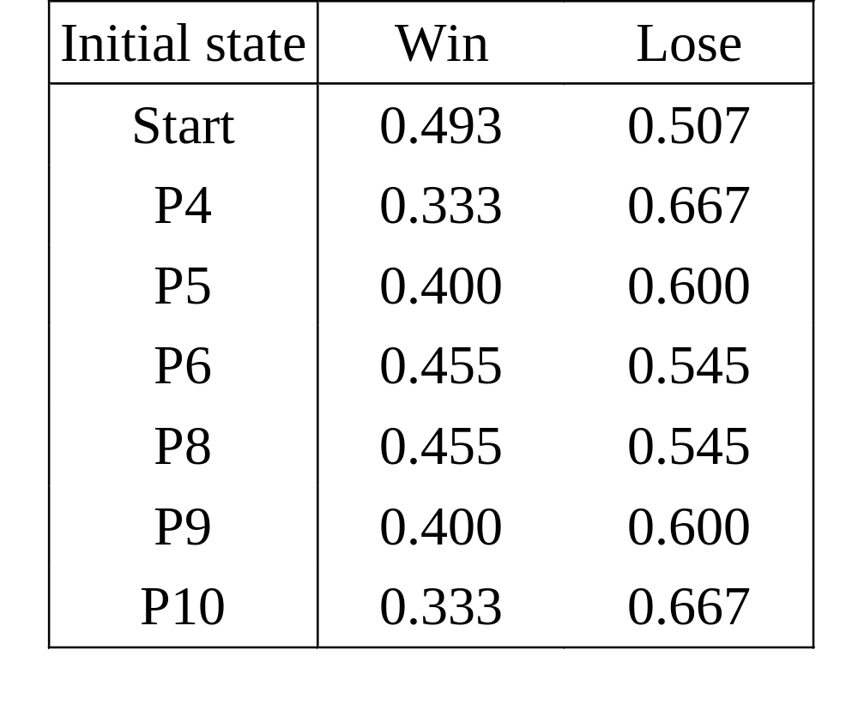
Absorbing State Probabilities for Craps

Slide 42
Interpretation of Steady-State Conditions
Just because an ergodic system has steady-state probabilities does not mean that the system “settles down” into any one state.
2. The limiting probability π_{j} is simply the likelihood of finding the system in state j after a large number of steps.
3. The probability that the process is in state j after a large number of steps is also equals the long-run proportion of time that the process will be in state j.
4. When the Markov chain is finite, irreducible and periodic, we still have the result that the π_{j}, j ∈ S, uniquely solve the steady-state equations, but now π_{j} must be interpreted as the long-run proportion of time that the chain is in state j.

Slide 43
What You Should Know About Markov Chains
How to define states of a discrete time process.
How to construct a state-transition matrix.
How to find the n-step state-transition probabilities (using the Excel add-in).
How to determine the unconditional probabilities after n steps
How to determine steady-state probabilities (using the Excel add-in).

